Slide 1
HIP Project Expo
Cincinnati Campus
June 7th, 2019
Molly Fisher
2020, Lakota West High School

Slide 2
Team
Nick Perrin
Software Engineer
Richard Hammond
Software Engineer
Molly Fisher, Junior
Lakota West

Slide 3
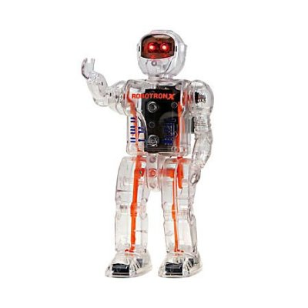
Project Description / Background
When I was first starting to drive I often had problems getting directions. My parents didn’t want me to drive on highways or specific roads, so I had to find my own way around. That gave me the idea to design an app that helps new drivers avoid dangerous routes.
New drivers often are not yet comfortable on the road and can easily be overwhelmed by an excess of traffic. Many apps that give directions only give the fastest routes when newer drivers need to take the safer ones
The goal of this app is to classify dangerous roads (where there are a high number of accidents), and to generate directions that avoid and/or show these area.

Slide 4
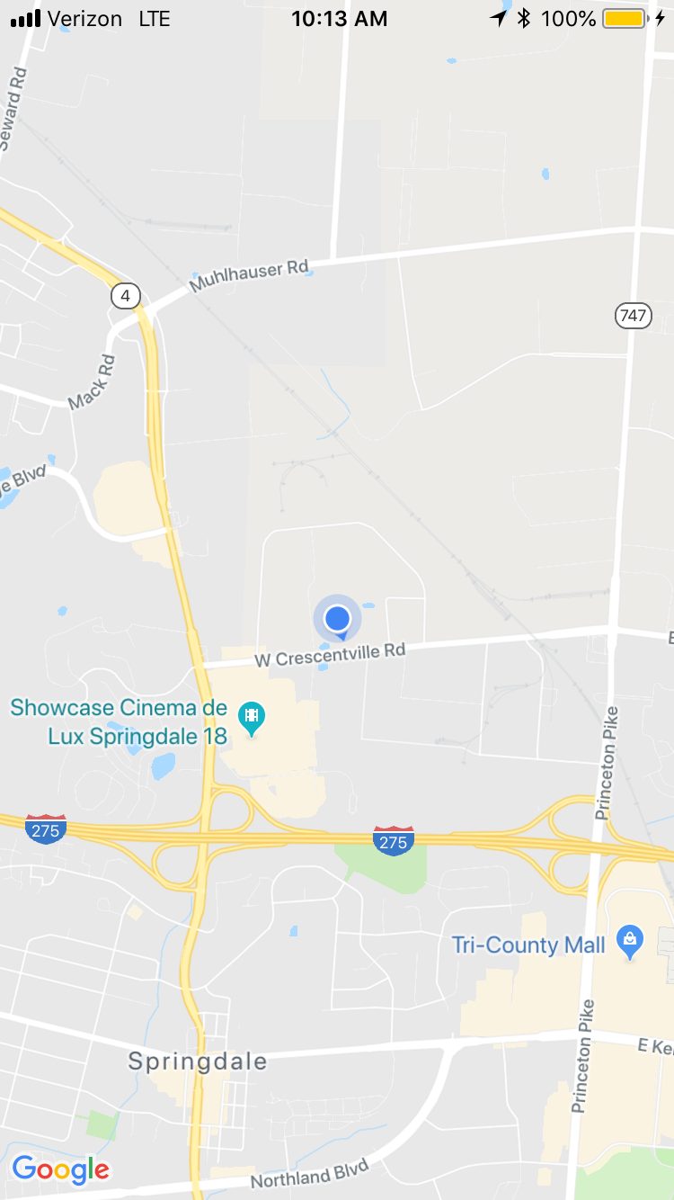
Approach / Process
Approach:
Research which api to use (Google or Apple)
Choose language (Swift, Java)
Classify dangerous routes (high accident, speed, traffic, highways/interstate)
User enhancements (weather avoidance, mute text alerts, connect with Siri)
Process:
Become familiar with Swift (Apple’s “Food Tracker” tutorial)
Become familiar with maps api via iOS tutorial
Get map displaying
Display current location on map
Take user input for destination
Process Google query to find route
Display route to user
Filter route data based on highway
storyboard for app.

Slide 5
Analysis/Results
XCode takes up a lot of resources when in use (up to 30 minuets to load)
Should have used a cross compiler
Hardware emulation uses a lot of resources
Running on hardware decreased time significantly
Future
Analyze traffic history. Can we find patterns that will indicate dangerous roads?

Slide 6
Learning Highlights / Conclusion
Learning Highlights
Learned basics of Swift language
Challenging with little to no programing experience
Learned to use source control (Git Hub)
Learned basic Linux commands
Learned importance of having more than one development option (stuck on older Mac)
Learned to query Google for route data
Learned how to layer storyboard in XCode
Conclusion:
Should have used a cross compiler. Starting with an easier language (more straight forward) would have been better.

Slide 7
Future Work / Connection to NGC
Future Work
Using different hardware would have improved project. Understanding traffic patterns would make project more robust.
Next: Display route to user
Next Year: Model rocket with sensors
Related Technology
Navigation systems
IT & Enterprise Solutions
​​Advanced Electronics
C4ISR

